Slide 1

PICK ITUP

Slide 2
PICK ITUP
ORDER YOUR STUFF AND PICK ITUP
Email : pickitup9x5@gmail.com
Instagram : pickitup9x5

Slide 3
WHAT WE DO ?
PICK ITUP is a start up which provide different types of services in which we deliver those products which are not available inside the campus.
SERVICE
NORMAL SERVICE
INSTANT SERVICE
In this service we deliver the product by next working day of order.
In this service we deliver the product by same day, after 3pm.

Slide 4
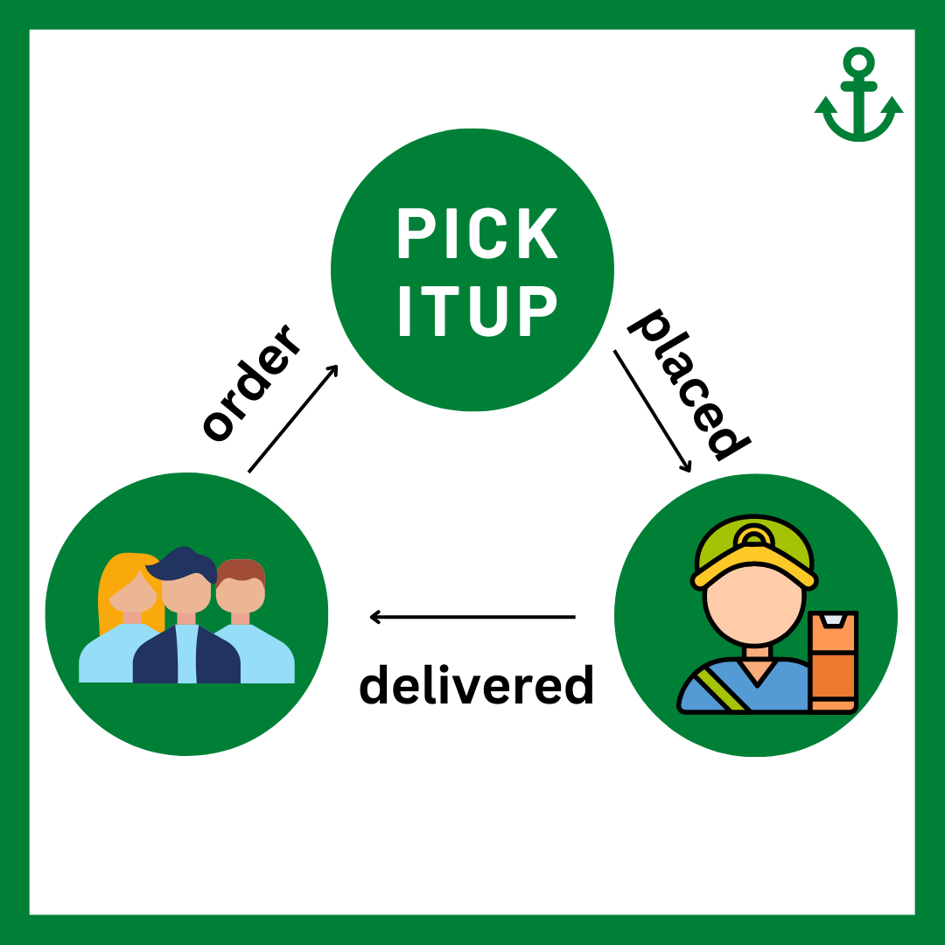
HOW PICK ITUP WORKS
PICK ITUP
Order is placed and allotted to employee.
CUSTOMER
EMPLOYEE (STUDENT)
Employee will confirm the order and will deliver the product the next working day.
Places an order on the website of pickitup.

Slide 5
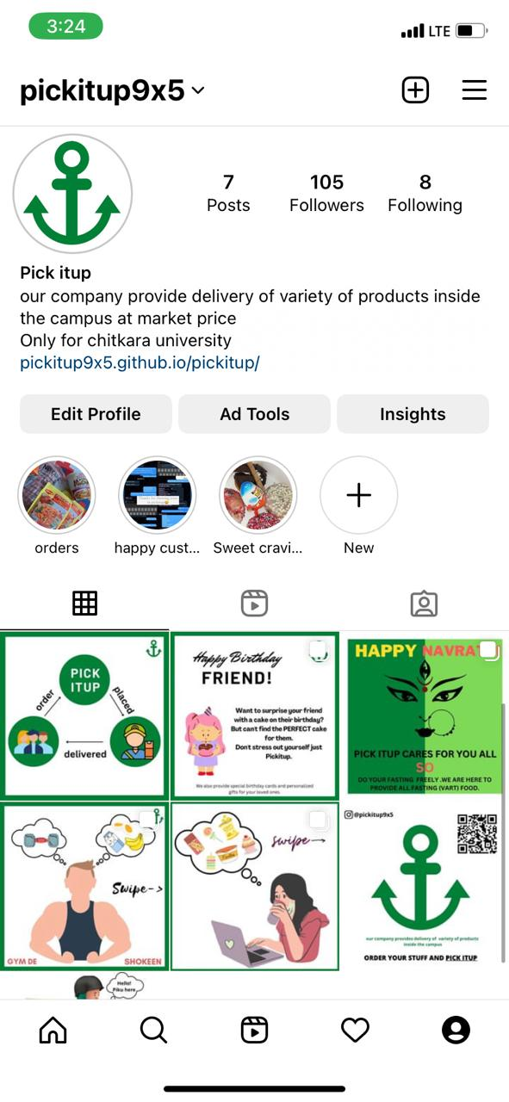
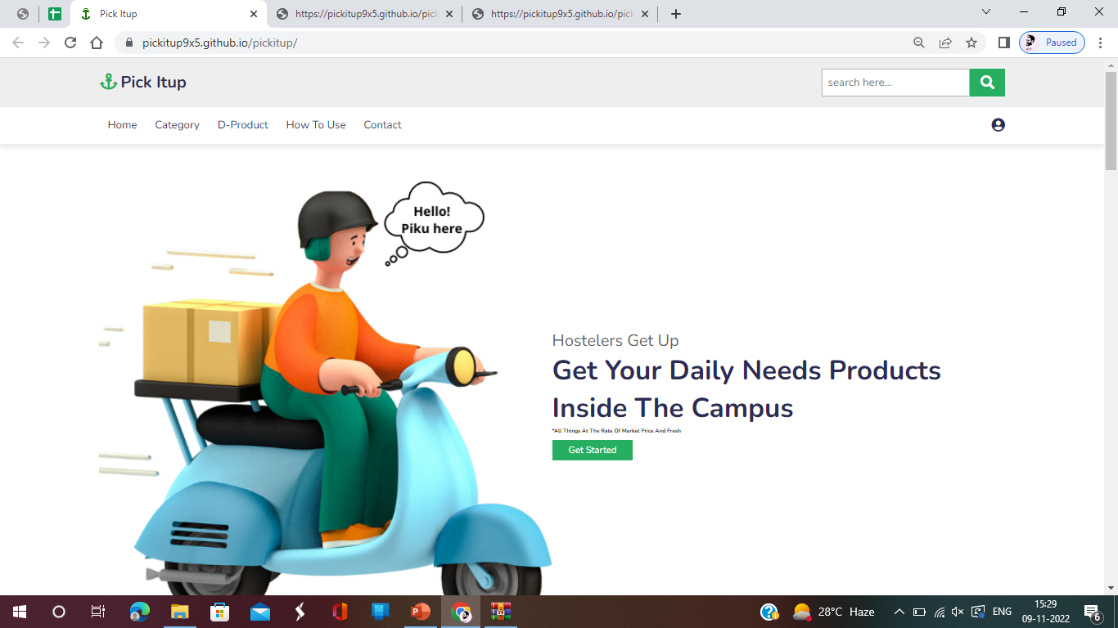
HOW TO USE PICK ITUP?
https://pickitup9x5.github.io/pickitup/

Slide 6
Parents feel unsecure to send their children outside the campus to buy basic necessity things.
Passive Income will be generated for students.
Due to lack of availability of hygiene products like girls have to compromise. E.g:- Sanitary napkins, bodywash etc.
Fresh products of great variety will be delivered to the students. E.g:- Fruits and vegetables.
Groceries items including dairy products, sweets, chips and many other will be made available in the campus.
No outsider or delivery boy will be allowed in the campus.
Medicine category is also provided.
Easy to use and provides comfort.
WHAT IS THE NEED OF PICK ITUP?

Slide 7
REVENUE GENERATION SYSTEM
Pre-payment is necessary to order products.
Minimum order of Rs.50 is accepted.
The major part of our revenue is generated from delivery charges which vary from category to category.
The products we buy from retailers, often gives discount on the MRP.
Additional Rs.50 + delivery charges are charged on instant delivery service.
Logistics cost is also zero.
On demand products like customized gifts, cakes etc. have higher margin than regular category.

Slide 8
FUTURE OF PICKITUP
Pickitup will soon be the leading hostel delivery service providing company in colleges and universities all over India.
Brands will do partnership with pickitup to advertise their products among the youth.
Pickitup points will be made in the campus and hostel for easy delivery of products.
Dairy products membership will be introduced.
Students will be employed to deliver goods , helping them to earn part time income without affecting studies.
Students will be paid on the basis of commission.
We will have useful insights of students.
Pickitup Mart will be installed near the campus.

Slide 9
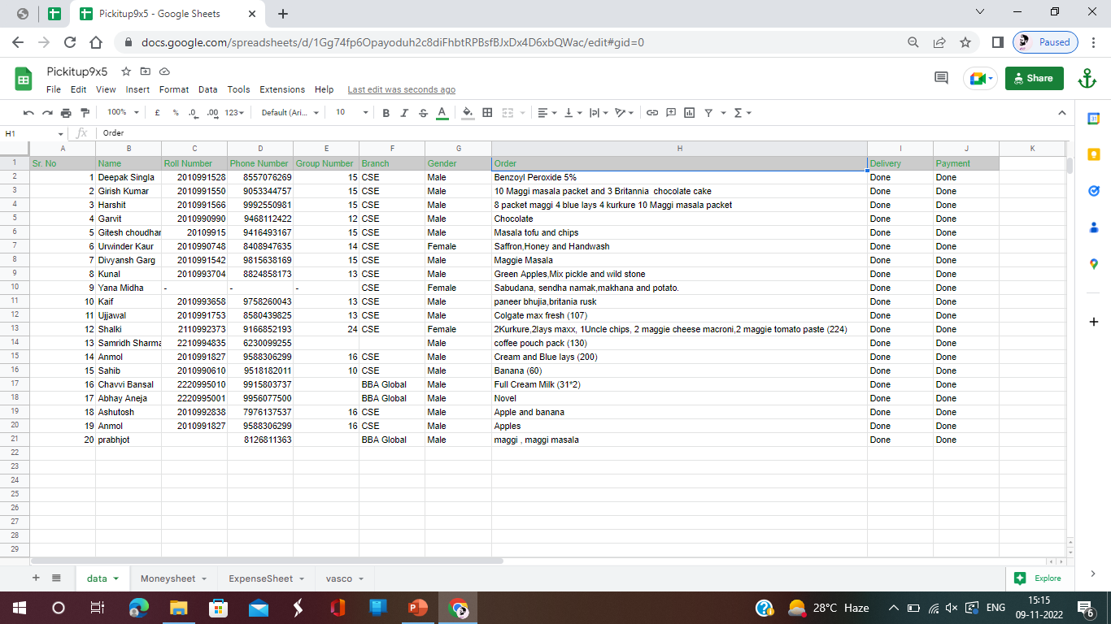
DATABASE OF STUDENTS

Slide 10
